Slide 1
Energy storage Systems – Electrical and Mechanical

Slide 2
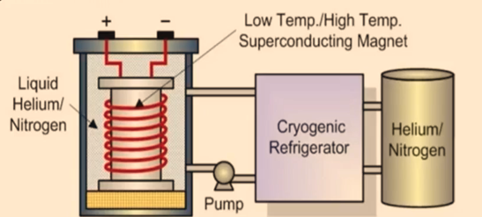
Energy Storage Systems - Electrical
Electrical
Electrical energy storage stores electrons in the
electrostatic field between two electrodes.
The energy capacity of this storage group is limited
but the reaction time is very fast.

Slide 3
Energy Storage Systems - Electrical
Superconducting Magnet Energy Storage(SMES):
• Store energy in the magnetic field .created by the flow of DC in a superconducting coil
• Cryogenically cooled to a temperature below its superconducting critical temperature.
Includes three parts:
• superconducting coil power conditioning system
• cryogenically cooled refrigerator.
• Once the superconducting coil is charged, the current
will not decay and the magnetic energy can be stored indefinitely.
• The stored energy can be released back to the
network by discharging the coil.

Slide 4
Energy Storage Systems - Electrical
• The power conditioning system uses an inverter/rectifier to
transform alternating current (AC) power to direct current or
convert DC back to AC power.
• The inverter/rectifier accounts for about 2—3% energy loss in each direction.
• SMES loses the least amount of electricity in the energy
storage process compared to other methods of storing energy.
• SMES systems are highly efficient; the round-trip efficiency is greater than 95%.

Slide 5
Energy Storage Systems – Electrical –SuperCapacitors.
Supercapacitor or
Ultracapacitor
Electrochemical doublelayer capacitors (EDLCs)
[charge storge:electrostatically
(helmholt Z layer)]
Electrochemicalpseudocapacitors
[charge storge:electrostatically
(faradaically)]
Hybrid capacitors
[charge storage: bothelectrostatically and
electrochemically]

Slide 6
Energy Storage Systems – Electrical –SuperCapacitors.
Supercapacitors:
• Also called an Ultracapacitor - High-capacity capacitor with a capacitance value much higher than other capacitors-
• But with lower voltage limits, that bridges the gap between electrolytic capacitors and rechargeable batteries.
• It typically stores 10 to 100 times more energy per unit volume than electrolytic capacitors - can accept and deliver charge much faster than batteries
• Tolerates many more and charge and discharge cycles than rechargeable batteries.
• The electrolyte forms an ionic conductive connection between the two electrodes - distinguishes them from conventional electrolytic capacitors - dielectric layer always exists - E.g., Mn02 or conducting polymer
• Supercapacitors are polarized by design with asymmetric electrodes

Slide 7
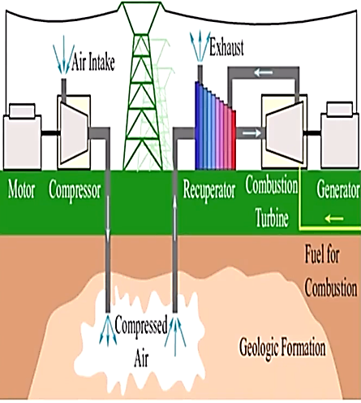
Energy Storage Systems - Mechanical
Mechanical
Mechanical energy storage combines several storage principles.
For example, it uses from the energy of water behind a dam in a hydropower storage - volume and pressure of the air in a compressed air energy storage.
Mechanical storage was traditionally the most utilized type of storage at a grid.

Slide 8
Energy Storage Systems - Mechanical
Compressed Air Energy Storage(CAES):
Compressed-air energy storage (CAES) is a way to store energy for later use using compressed air.
At a utility scale, energy generated during periods of low demand can be released during peak load periods.
The global shift towards renewable energy has led to a renewed interest in CAES systems, to help highly intermittent energy sources like photovoltaics and wind satisfy fluctuating electricity demands.

Slide 9
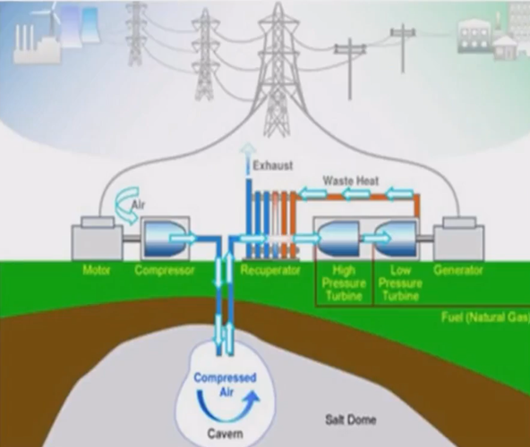
Energy Storage Systems - Mechanical
One ongoing challenge in large scale CAES design is the management of thermal energy
since the compression of air leads to an unwanted temperature increase
that not only reduces operational efficiency but can also lead to damage.
The main difference between various CAES architectures lies in thermal engineering.
On the other hand, small-scale systems have long been used as propulsion of mine locomotives.
Compared to traditional batteries, CAES systems can store energy for longer periods of time and have less upkeep.

Slide 10
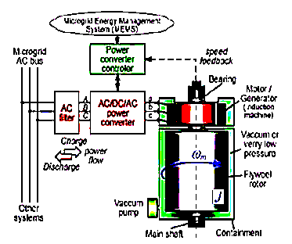
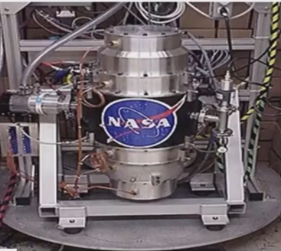
Energy Storage Systems - Mechanical
Flywheels:
Flywheel energy storage (FES) works by accelerating a rotor (flywheel) to a very high speed and maintaining the energy in the system as rotational energy.
When energy is extracted from the system, the flymheel's rotational speed is reduced as a consequence of the principle of conservation of
energy; adding energy to the system correspondingly results in an increase in the speed of the flywheel.

Slide 11
Energy Storage Systems - Mechanical
Most FES systems use electricity to accelerate and decelerate the flywheel, but devices that directly use mechanical energy are being developed.
Advanced FES systems have rotors made of high strength carbon-fiber composites, suspended by magnetic bearings, and spinning at speeds from 20,000 to over 50,000 rpm in a vacuum enclosure.
Such flywheels can come up to speed in a matter of minutes — reaching their energy capacity much more quickly than some other forms of storage.

Slide 12
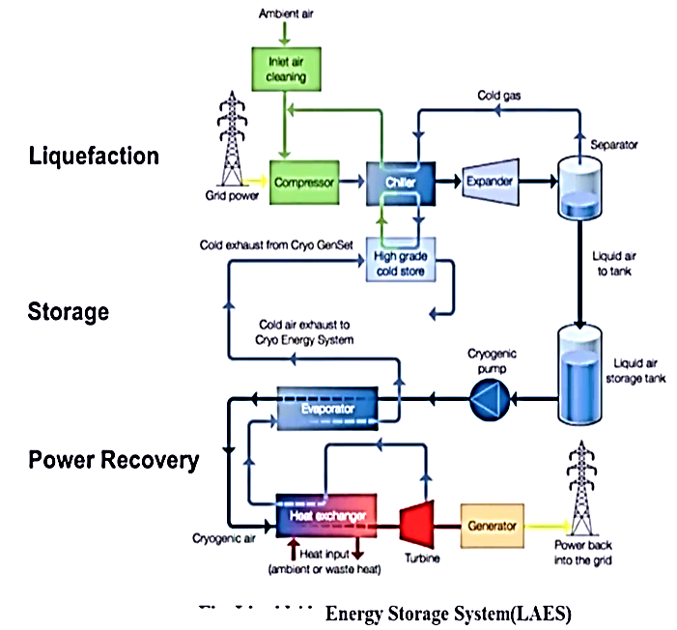
Energy Storage systems - Mechanical
Liquid Air Energy Storage(LAES):
Liquid Air Energy Storage (LAES) is sometimes referred to as Cryogenic Energy storage (CES).
The word "cryogenic" refers to the production of very low temperatures.
Cryogenic energy storage (CES) is the use of low temperature (cryogenic) liquids such as liquid air or liquid nitrogen to store energy.
The technology is primarily used for the large-scale storage of electricity.

Slide 13
Energy Storage Systems - Mechanical
When it is cheaper (usually at night), electricity is used to cool air from the atmosphere to -195 oc using the Claude Cycle to the point where it liquefies.
The liquid air, which takes up one-thousandth of the volume of the gas, can be kept for a long time in a large vacuum flask at atmospheric pressure.
At times of high demand for electricity, the liquid air is pumped at high pressure into a heat exchanger, which acts as a boiler.
Air from the atmosphere at ambient temperature, or hot water from an industrial heat source, is used to heat the liquid and turn it back into a gas.
The massive increase in volume and pressure from this is used to drive a turbine to generate electricity.

Slide 14
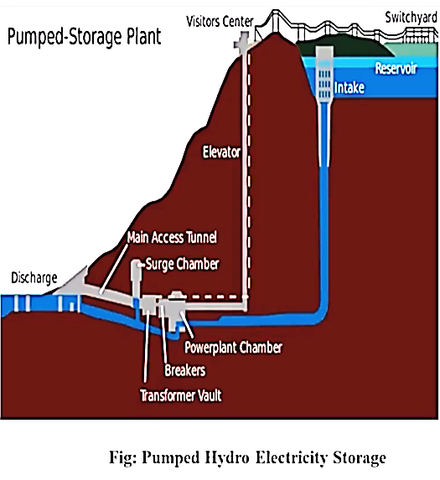
Energy Storage Systems- Mechanical
Pumped Hydro Storage:
Pumped-storage hydroelectricity (PSH) or pumped hydroelectric energy storage (PHES), is a type of hydroelectric energy storage used by electric power systems for load balancing.
The method stores energy in the form of gravitational potential energy of water, pumped from a lower elevation reservoir to a higher elevation.
Low-cost surplus off-peak electric power is typically used to run the pumps. During periods of high electrical demand, the stored water is released through turbines to produce electric power.

Slide 15
Energy Storage Systems- Mechanical
Although the losses of the pumping process make the plant a net consumer of energy overall, the system increases revenue by selling more electricity during periods of peak demand, when electricity prices are highest.
If the upper lake collects significant rainfall or is fed by a river then the plant may be a net energy producer in the manner of a traditional hydroelectric plant.

Slide 16
Thank you

